Slide 1
String

Slide 2
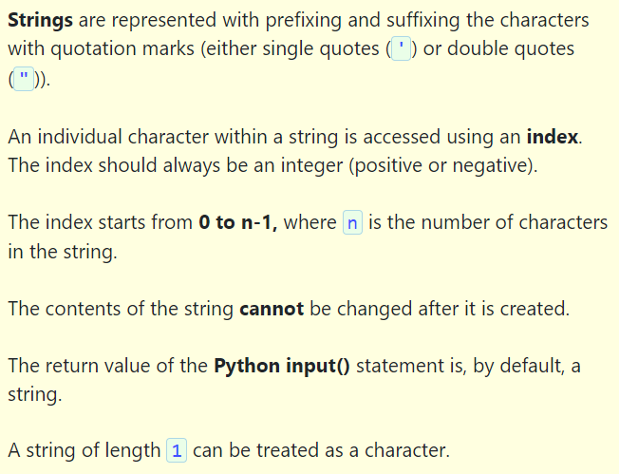

Slide 3



Slide 4
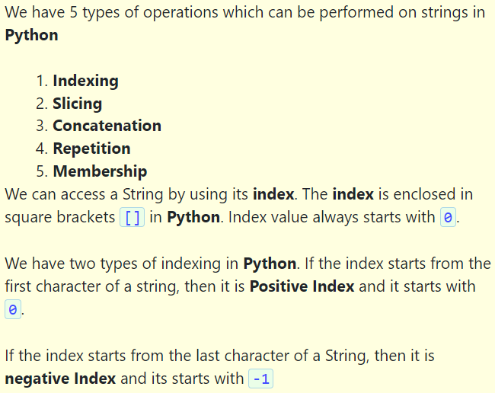

Slide 6
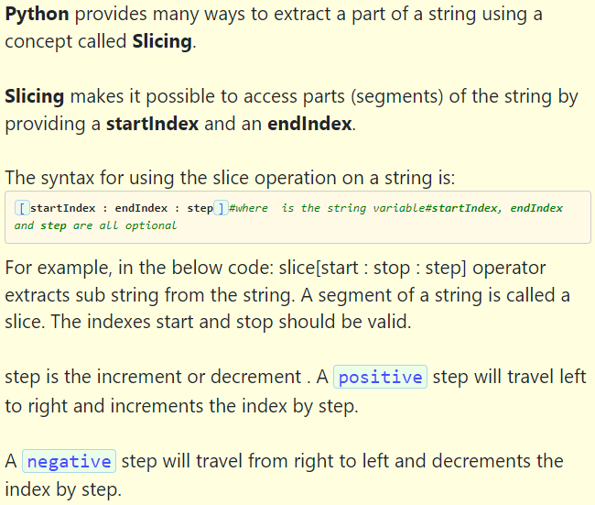

Slide 7
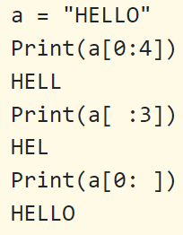
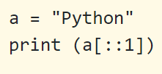

Slide 8
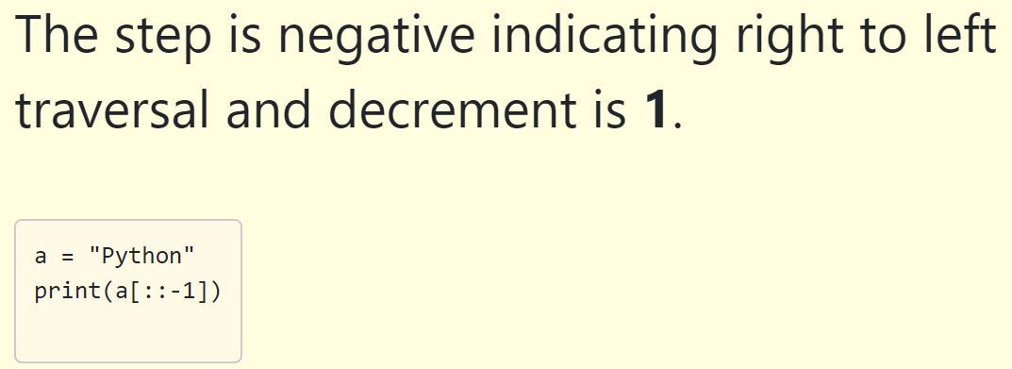

Slide 9




Slide 10
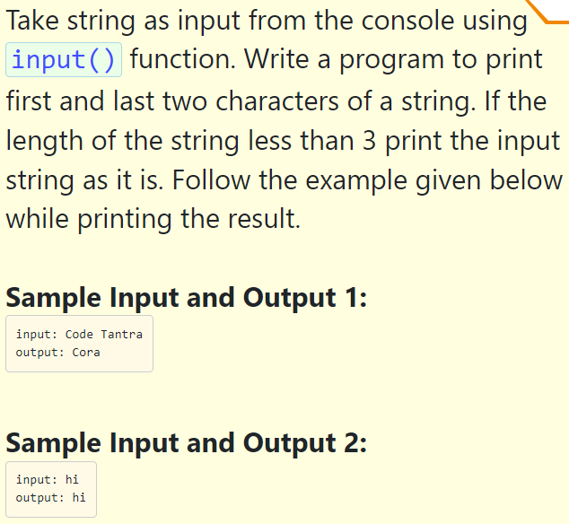

Slide 11
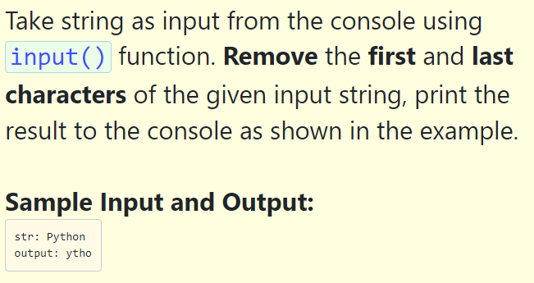

Slide 12
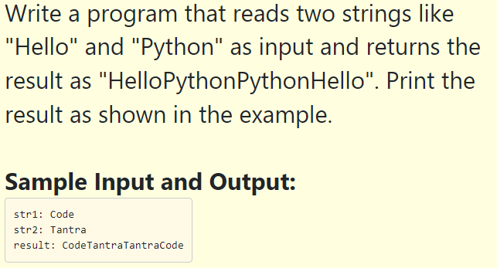

Slide 13
String function
capitalize() | Converts the first character to upper case
count() | Returns the number of times a specified value occurs in a string
find() | Searches the string for a specified value and returns the position of where it was found
lower() | Converts a string into lower case
upper() | Converts a string into upper case
title() | Converts the first character of each word to upper case
swapcase() | Swaps cases, lower case becomes upper case and vice versa
index() | Searches the string for a specified value and returns the position of where it was found

Slide 14
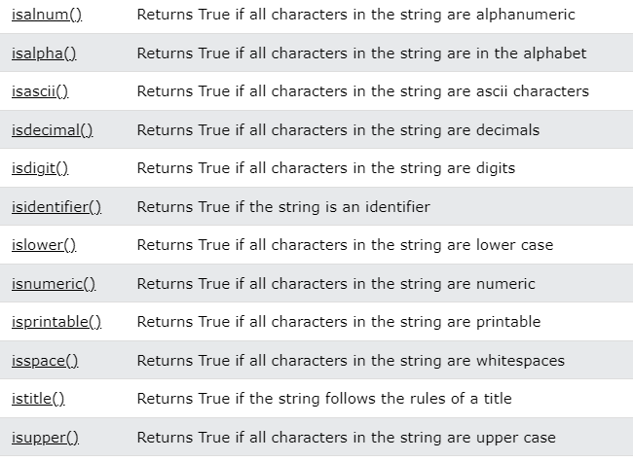

Slide 15
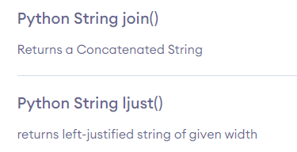
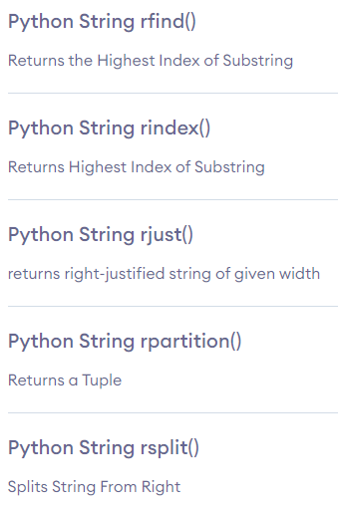
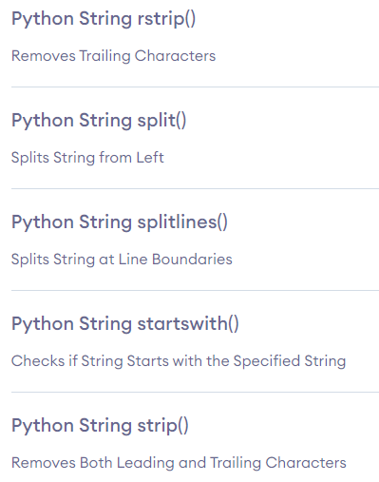

Slide 16
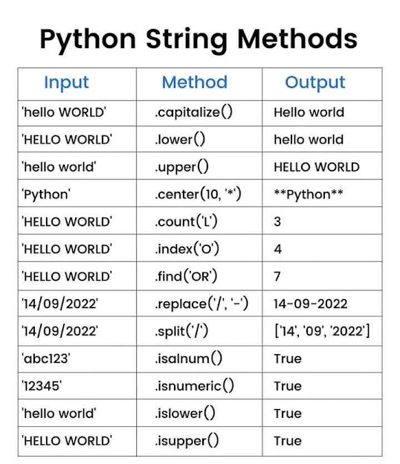
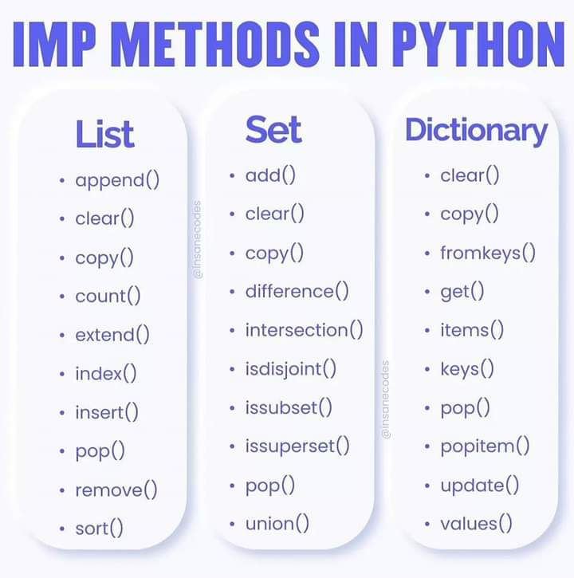

Slide 17
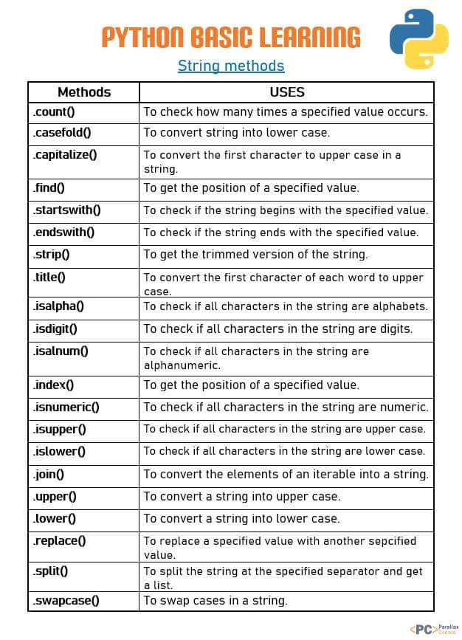

Slide 18
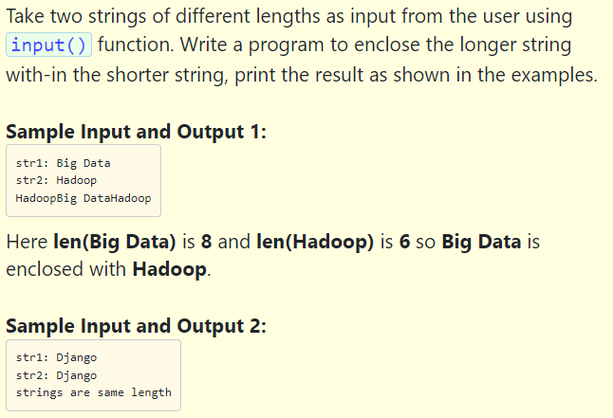

Slide 19
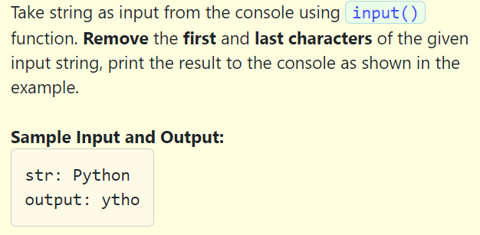

Slide 20
String Programs
Write a program to count vowels in a string.
Write a program to count characters in a string.
Write a program to reverse a string
Write a program to print a substring made of the first 2 and the last 2 chars
Write a program to print all substring of a string.
Python Program to Remove all special characters From a String
Write a program to check a string is a correct gmail id or not.
Python Program to Check If Two Strings are Anagram
Python Program to print all the Permutation of the String
Python Program to Count the Number of Occurrence of a Character in String

Slide 21
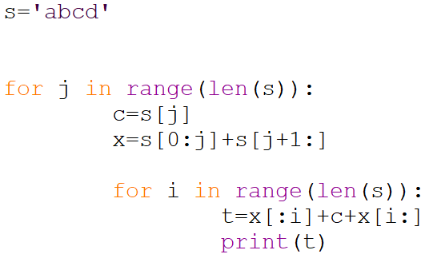

Slide 22
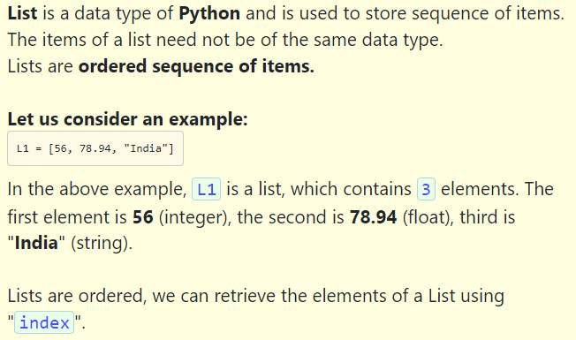

Slide 23
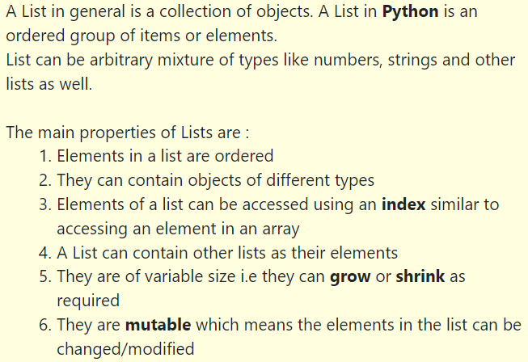
List Method

Slide 24
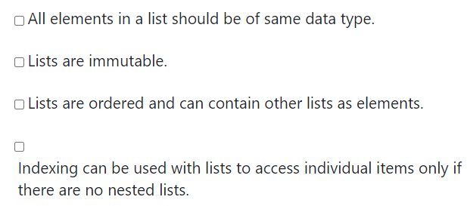

Slide 25
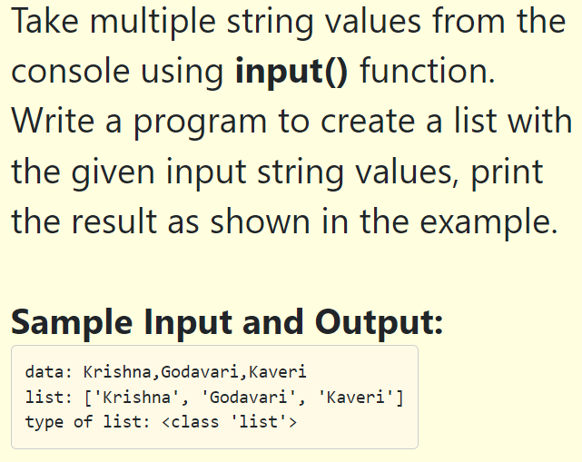

Slide 26
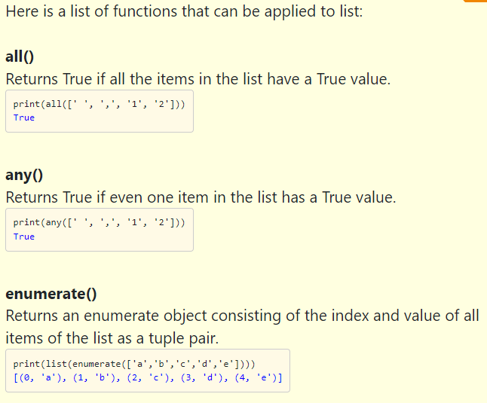

Slide 27
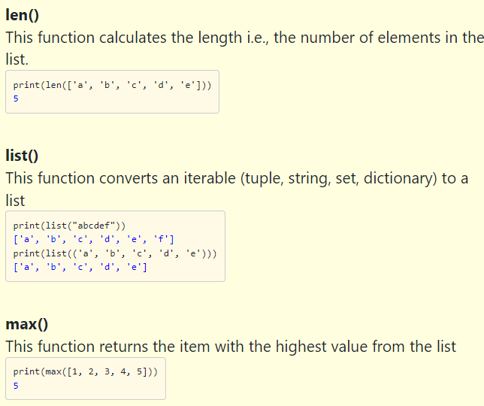

Slide 28
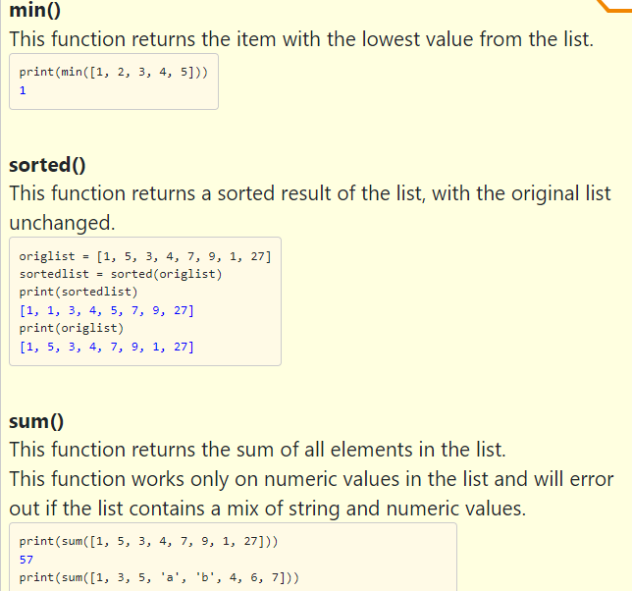

Slide 29
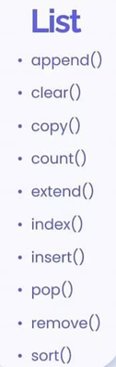
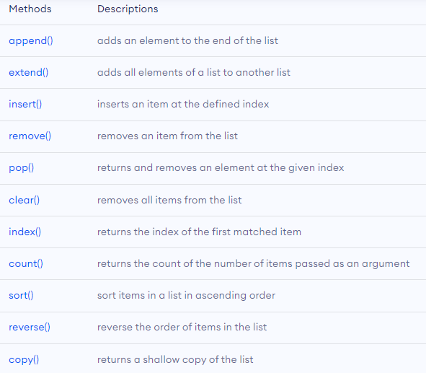
List Method

Slide 30
List Programs
Write a program to merge the two sorted list
Write a program to print common elements from two lists.
Print alternating elements of the list.
Write a program to Interchange First and Last Element of a List
Python program to find the cumulative sum of elements of a list
Program to find the position of minimum and maximum elements of a list.
Program to remove duplicate elements from the list.
Python program to find N largest and smallest elements from the list
Check all elements are unique or not

